Slide 1
SMART PARK
AUTOSLOT SEEKERS
University of Visvesvaraya College of Engineering
Theme - 2 (Innovation Track)
Fathima (EEE) - Team Captain, HW
Vibha (EEE) - ML Integration
Vishal (Mech) - Website Development
Akanksh (ECE) - Hardware Integration
Nalin (ECE) - Database Integration

Slide 2

Problem Statement
Vision: Create a seamless solution for pre-booking and reserving parking slots across multiple lots.
Problem: Addresses the critical lack of parking infrastructure in major cities, a key contributor to traffic congestion.
Impact: Solves a universal challenge for automobile owners seeking efficient parking.
Intelligent Parking Spot Finder

Slide 3
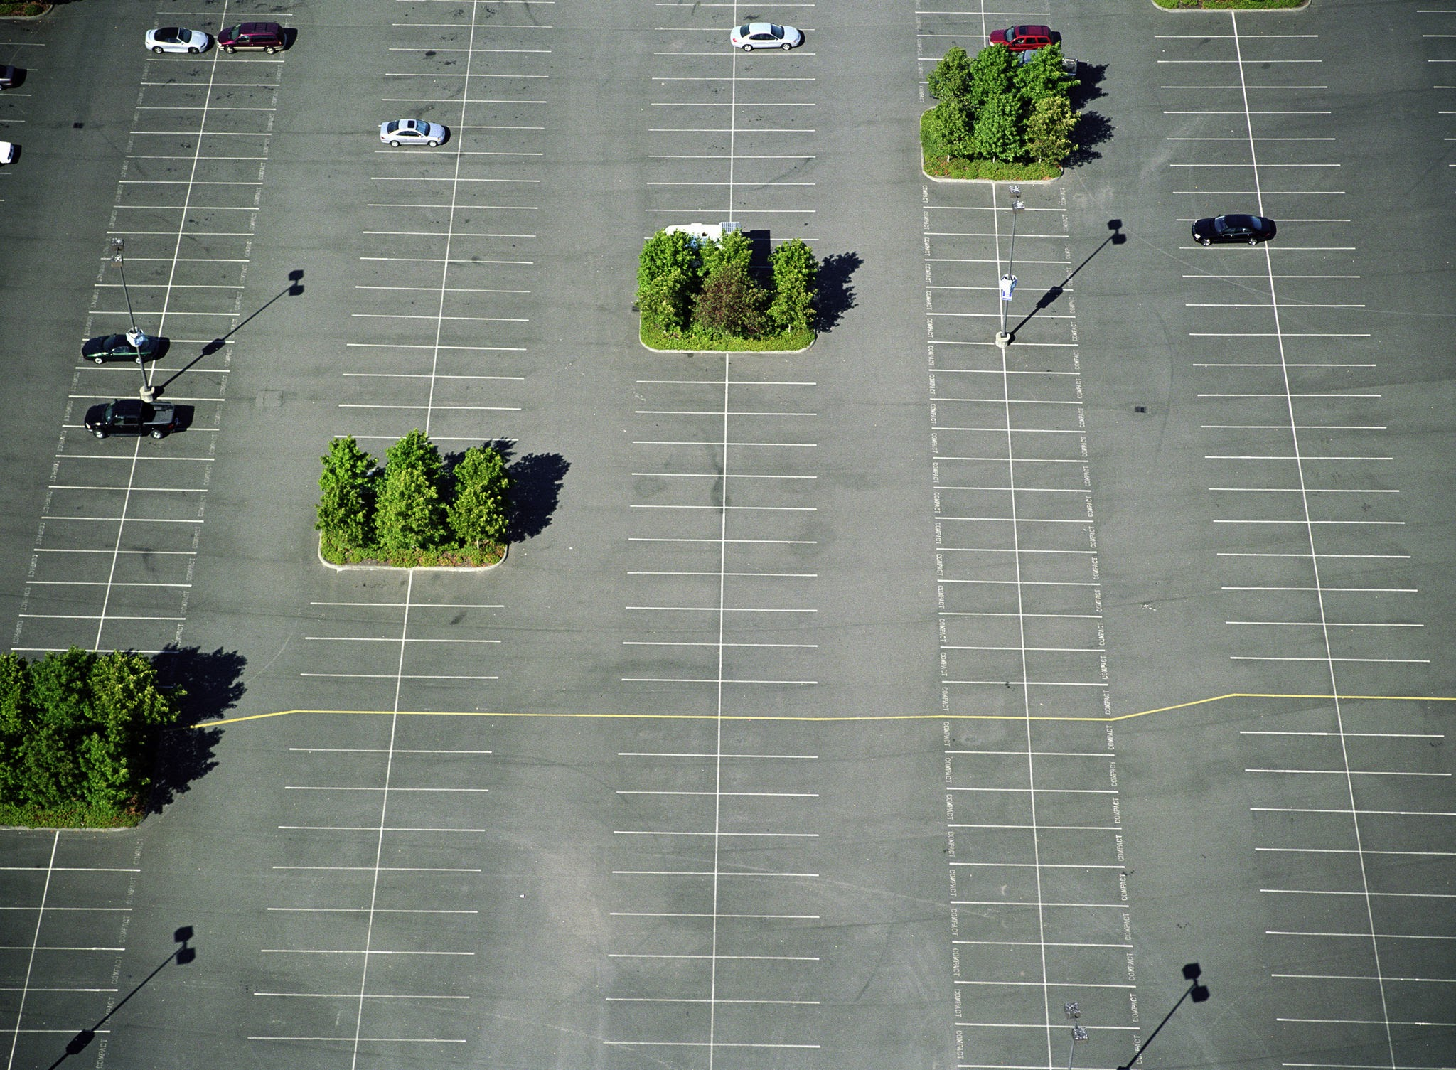
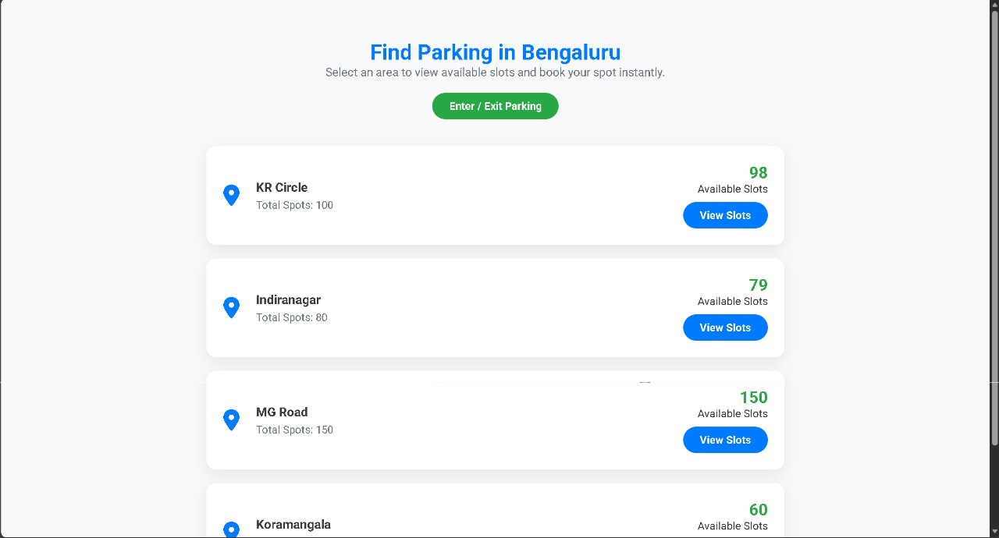
Proposed Solution
Effortless Parking Management: Locate, select, and reserve parking slots across multiple lots via a user-friendly web interface.
Seamless Payments: Integrated RazorPay for secure and quick transactions.
Automated Access: Unique ID generation for smooth, human-intervention-free entry and exit.
Core Innovation: Pre-booked Time Slots: Reserve specific parking durations with the flexibility to extend (penalties apply for overstay).
Cost Efficiency: Minimize labor costs through automated entry/exit validation.

Slide 4
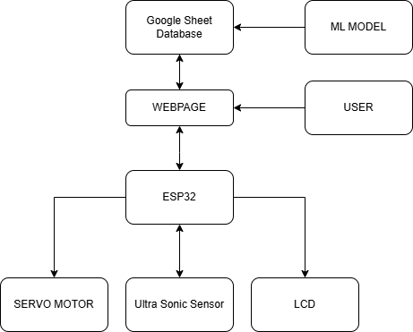
BLOCK DIAGRAM

Slide 5
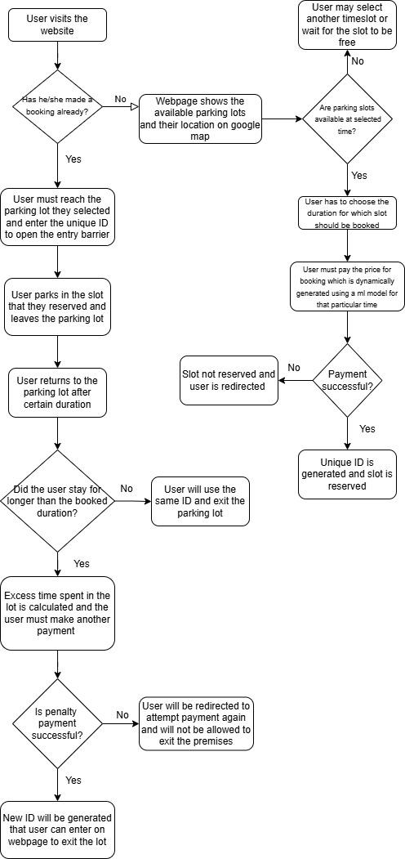
Technical Approach
Platform: Locally Hosted Web Application
Backend: NodeJS Server
Frontend: HTML & CSS
Database: Google Sheets (via Google App Script & APIs)
Dynamic Pricing ML: TinyML & TensorFlow
Location Services: Google Maps API
Payment Gateway: RazorPay
Hardware: ESP32 for Ultrasonic Sensors & Servo Motor (Gate Control)
Flow of the Solution

Slide 6
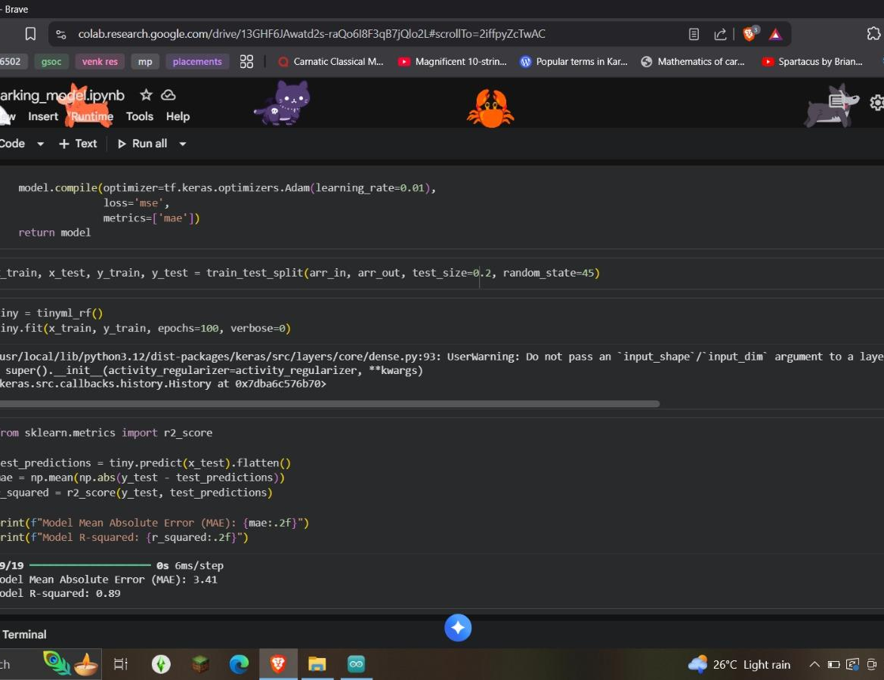
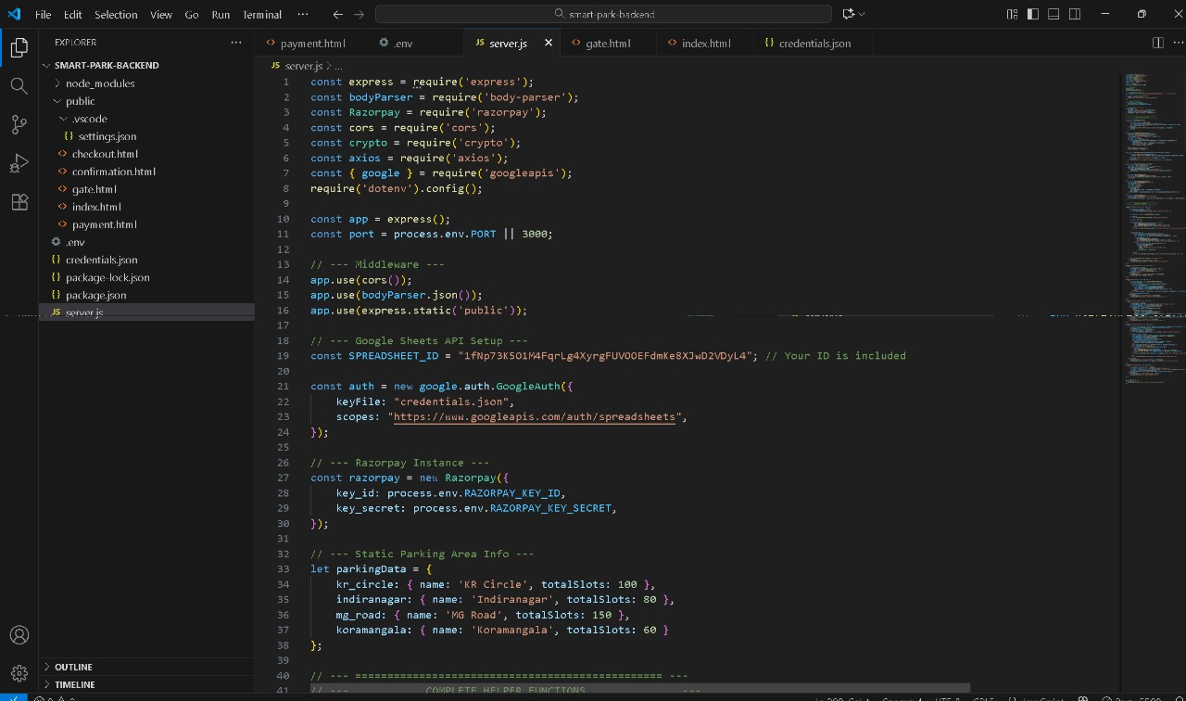
Implementation / Demo Overview
Developed a smart parking management system enabling users to book slots, make secure payments, and track real-time availability through a responsive web interface built with HTML, CSS, and Node.js.
Integrated Razorpay payment gateway for seamless and secure online transactions during the booking process.
Designed and implemented the hardware system using ESP32, ultrasonic sensors, LCD display, and servo motors to detect vehicle presence, display slot status, and control gate movement.
Enabled dynamic fare calculation based on parking duration, providing an efficient, automated, and user-friendly parking experience.

Slide 7
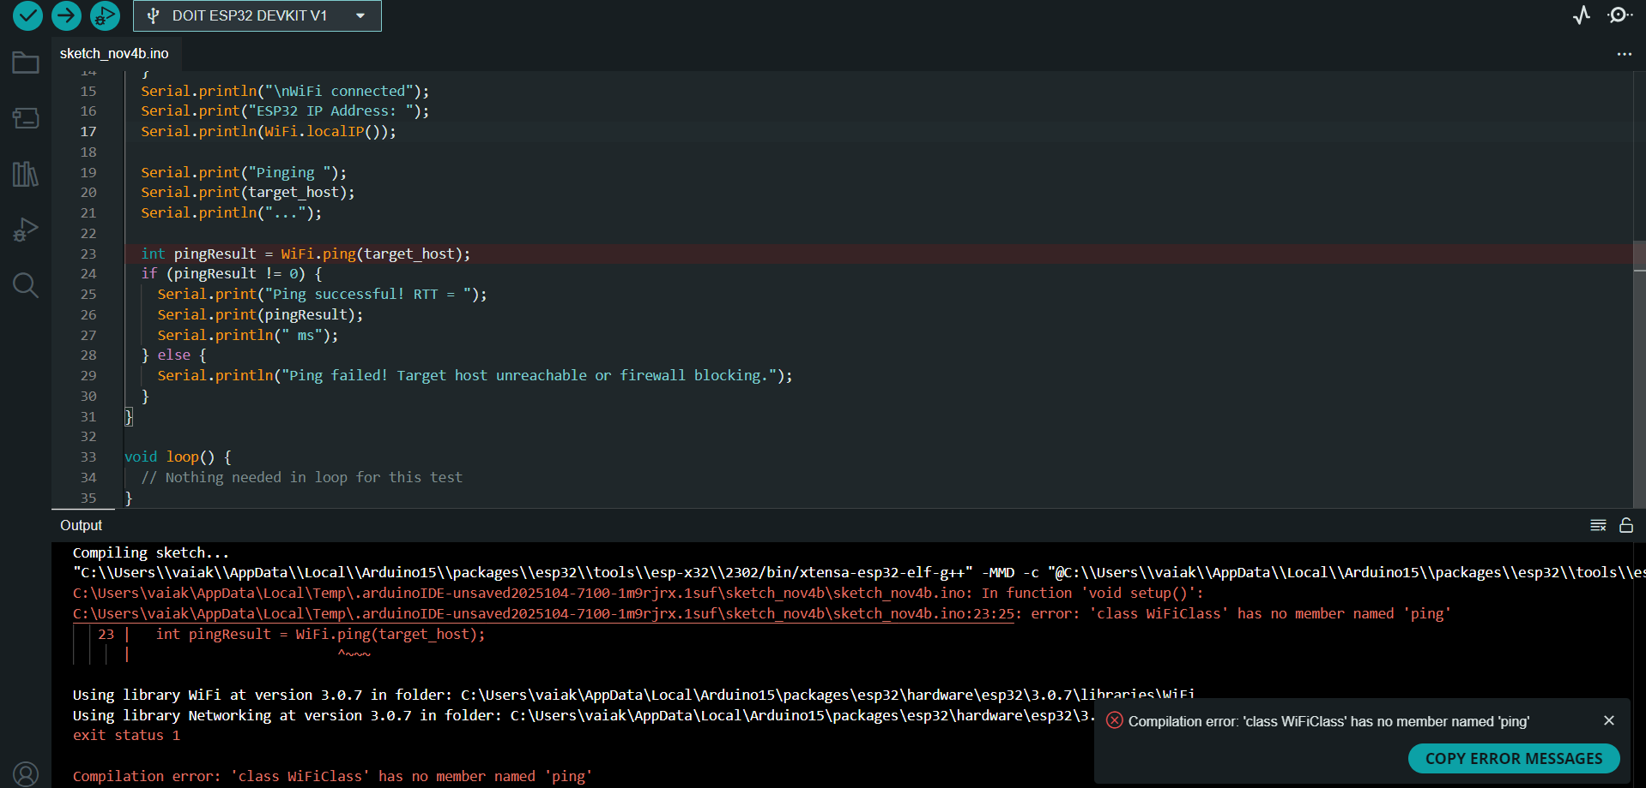
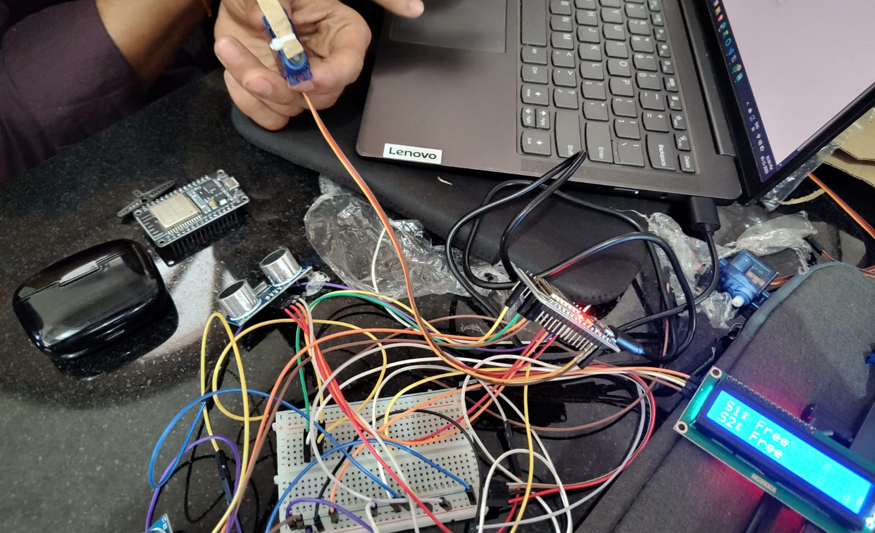
Challenges & Learning
Challenges:
Integrating the website with the ESP32 hardware.
Integrating and running the ML model.
Debugging issues across hardware, front end, and back end.
Learnings:
Gained experience in hardware–software integration using APIs.
Learned to create and manage API calls for real-time data exchange.
Learned to debug hardware by checking with example codes.

Slide 8
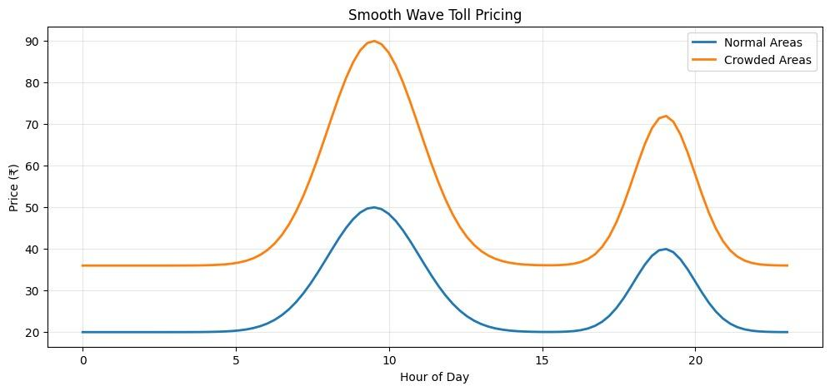
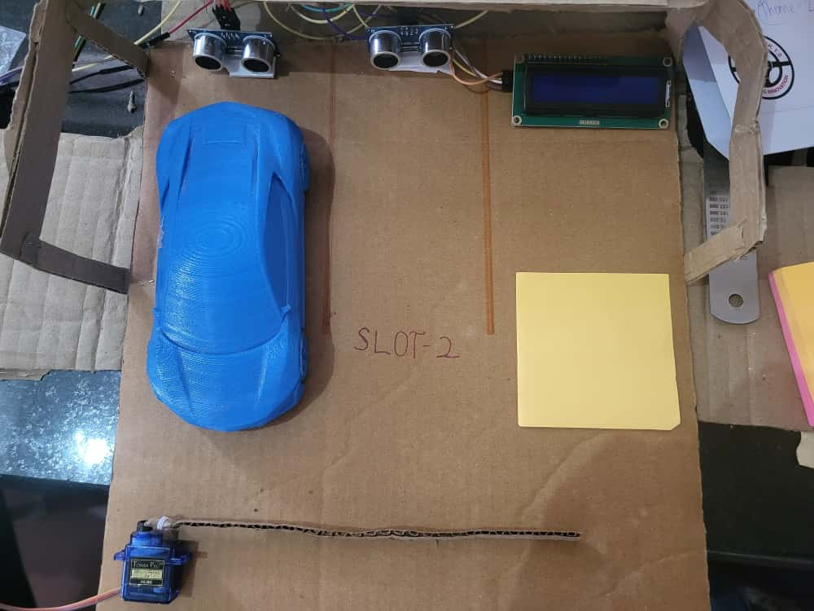
Result & Impact
Time Savings: Drastically reduce parking search time.
Cost Efficiency: Automated entry/exit and inexpensive sensors slash operational costs.
Real-time Accuracy: Highly accurate, live status of all parking slots.
Scalability: Easily expand to multiple lots with minimal modifications.

Slide 9

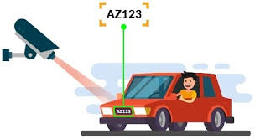
Future Enhancements
Smarter Pricing: Data-driven dynamic pricing, optimizing for peak demand.
Enhanced Security: Vehicle number integration to prevent slot mix-ups.
Streamlined Access: QR code readers for faster entry and exit.
Full Scalability: Web hosting, robust database, and expanded sensor network for multi-lot deployment

Slide 10
Acknowledgement
Huge thanks to all the Jury members for their valuable feedback and suggestions!!
Data sources used were for ML training like OpenStreetMap and a lot Google’s functions like Google API, Google Sheets and Google Appscripts played a vital role in realizing this solution.

Slide 11


THANK YOU !!
Fathima (EEE) - fathimazahra7049@gmail.com
Vibha (EEE) - vibha.hul@gmail.com
Vishal (Mech) - vishalgarande01@gmail.com
Akanksh (ECE) - kottariakanksh003@gmail.com
Nalin (ECE) - nalinjayvyas@gmail.com

